Slide 2
What’s new in Visual Studio 2015
Guy Bertental
Cloud Solution Architect
@microsoft.com
Notes:
שלום לכולם וברוכים הבאים לכנס SDP 2016
שמי גיא ברטנטל ואני ארכיטקט פתרונות לענן בחברת מקרוסופט
אני עובד בצוות ה CTO המונה כ 24 ארכיטקטים אשר כל אחד מגיע מתחום שונה, בין עם זה BigData, ML, תשתיות, תקשורת.
אני אישית מגיע עם ניסיון של כ 18 שנה בפיתוח וניהול פיתוח מוצרים בטכנולוגיות של מקרוסופט וקוד פתוח.

Slide 3
Agenda
Microsoft Vision
Visual Studio products
Xamarin Acquisition
What’s new – Demos
Extra
Notes:
שלום לכולם וברוכים הבאים לכנס SDP 2016
שמי גיא ברטנטל ואני ארכיטקט פתרונות לענן בחברת מקרוסופט
אני עובד בצוות ה CTO המונה כ 24 ארכיטקטים אשר כל אחד מגיע מתחום שונה, בין עם זה BigData, ML, תשתיות, תקשורת.
אני אישית מגיע עם ניסיון של כ 18 שנה בפיתוח וניהול פיתוח מוצרים בטכנולוגיות של מקרוסופט וקוד פתוח.

Slide 4
Microsoft Development Approach
Powerful
Open
Productive
Notes:
מקרוסופט משקיע המון בכלי הפיתוח לספק לכם את פלטפורמה וכלי הפיתוח הטובים ביותר, בכך:
1. להעצים אתכם, המפתחים כך שתוכלו לפתח ולתחזק מגוון רחב של תוכנות בקלות וביעילות.
2. הגישה החדשה של מיקרוסופט הינה גישה פתוחה, כלומר תוכלו לפתח תוכנות אשר ירוצו על כל מערכת הפעלה, בין אם זה לינוקס, IOS או android.
3. ולאפשר עבודה עם כלי קוד פתוח מכיוון שאנחנו מאמינים שתרומה של כל מפתח לקהילה שווה המון.

Slide 5

The Visual Studio family
Code
Team Services
Most complete developer IDE
Code Optimized Editor
Cloud services for teams
Best-in-class tools for every developer and every team
Notes:
מיקרוסופט מספקת כיום תחת משפחת VS 3 מוצרים
VSIDE – פלטפורמת פיתוח מלאה לכל סוגי התוכנות
VSCODE – כלי עריכת קוד קליל ומהיר מאוד המותאם במיוחד לעריכת קוד – הכלי יכול לרוץ על windows, mac & Linux
VSTS – מוצר SaaS הנועד לניהול מלא מקצה לקצה של כל מחזור החיים של התוכנה.
אנחנו נתמקד בעיקר כיום ב VSIDE

Slide 6
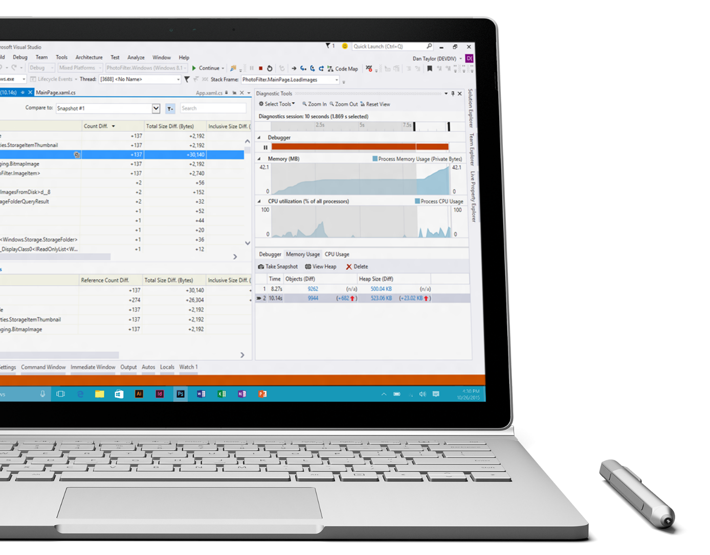
Visual Studio momentum
12.7M+ Visual Studio 2015 downloads
6K+ extensions in gallery
950K+ extension downloads per month
Notes:
הנתונים הנ"ל נכונים לכנס Build 2016 שנערך לאחרונה

Slide 7


Slide 8


Tools and services for any developer, any app
Windows
Linux
iOS
Android
.NET
C++
JavaScript
PHP
Python
Node.js
R
Cordova
Unity

Slide 9
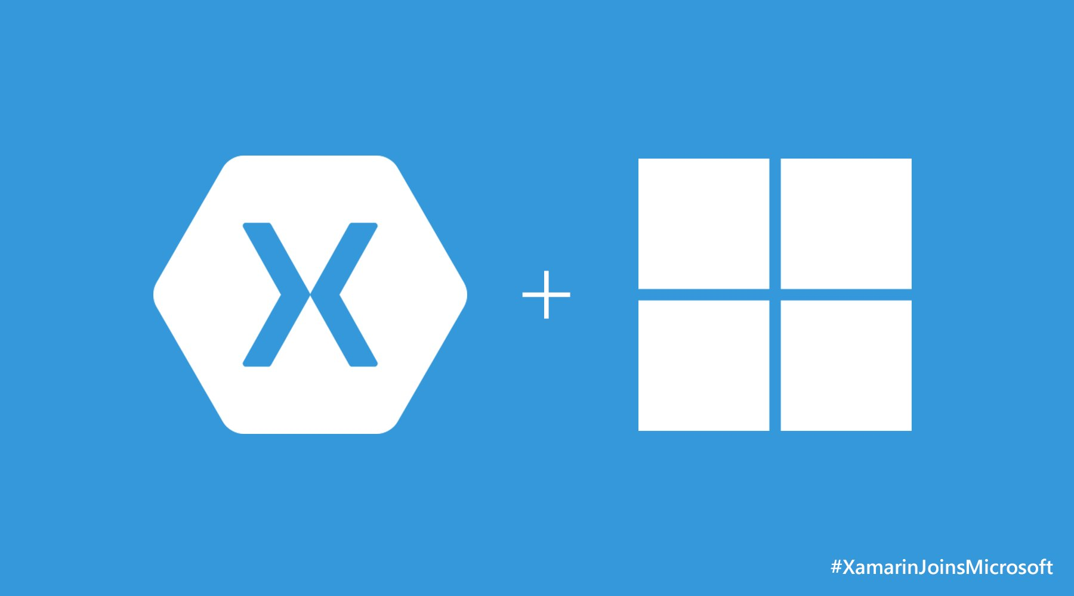
Notes:
בטח שמעתם על זה שמקרוסופט רכשה את חברת xamarin לפני מספר חודשים...

Slide 10
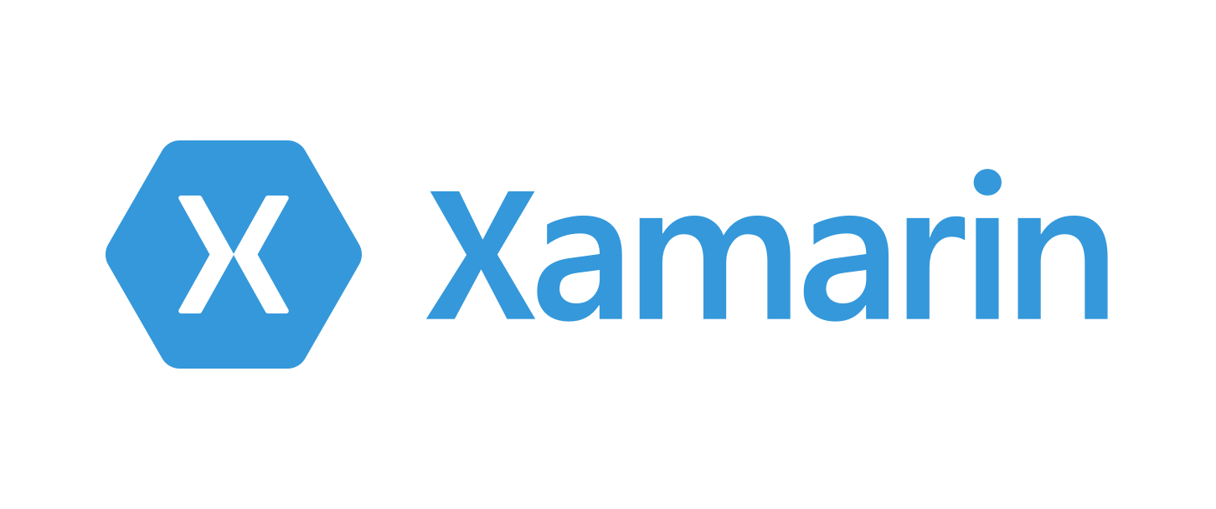
Notes:
Xamarin מאפשרת לכם לפתח אפליקציות נייטיב ב C# והכלי ממיר לבדו בעזרת Mono את הקוד שלהם לאנדרואיד ו IOS.
דבר נוסף הוא שזה מאפשר לכם לעשות reuse של לוגיקת UI בין הסוגים השונים של הdevices.
לקוחות שלנו – Rumble ו- MyState אשר דברו בכנס ההכרזה הרשמי על זאמרין במקרוסופט סיפרו שכלי חסך להם עד כ 50% קוד.

Slide 11
41%
of Enterprises
Choose Native
2014
Gartner.
Notes:
לפי גרטנר ב 2014 41% מהארגונים בחרו לפתח את האפלקציות שלהם בנייטיב

Slide 12
58%
of Enterprises
Choose Native
2015
Gartner.
Notes:
ב 2015 אחוז זה גדל ל 58%

Slide 13

Notes:
לא סתם אנחנו רואים את המגמה הזו, הסיבות הם שבפיתוח נייטיב אנחנו משיגים ביצועים טובים יותר, רכיבי נייטיב של UI,
וגישה ל Native API וכל זאת כדי להוציא את המיטב מכל device.
וזה בדיוק מה שזאמרין מכוונת אליו.

Slide 14
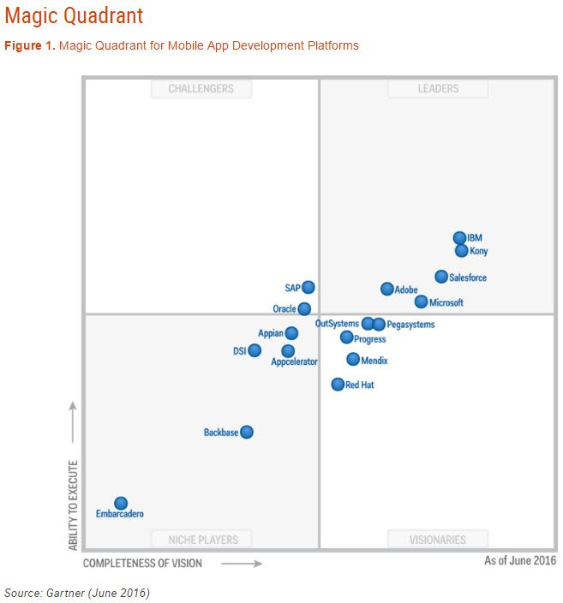
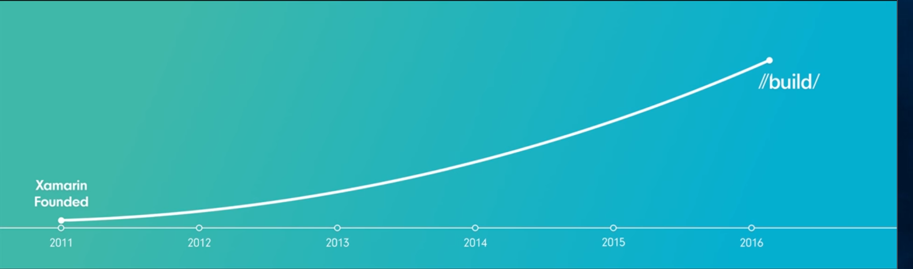
Microsoft a Mobile Application Development Platform leader in Gartner’s Magic Quadrant
The best development tools in a single package
Sophisticated mobile DevOps
Putting developers first
Notes:
רק שלושה חודשים מאז ההודעה של מקרוסופט על הרכישה וכבר גרטנר פרסמה שמקרוסופט קפצה לרביעי הרביעי ב Magic Quadrant בתחום של פלטפורמת פיתוח אפליקציות מובייל.

Slide 15
Visual Studio 2015 products
Visual Studio 2013
PROFESSIONAL WITH MSDN
PREMIUM WITH MSDN
ULTIMATE WITH MSDN
MSDN PLATFORMS
TEST PROFESSIONAL WITH MSDN
Visual Studio 2015
PROFESSIONAL WITH MSDN
ENTERPRISE WITH MSDN
MSDN PLATFORMS
TEST PROFESSIONAL WITH MSDN

Slide 16
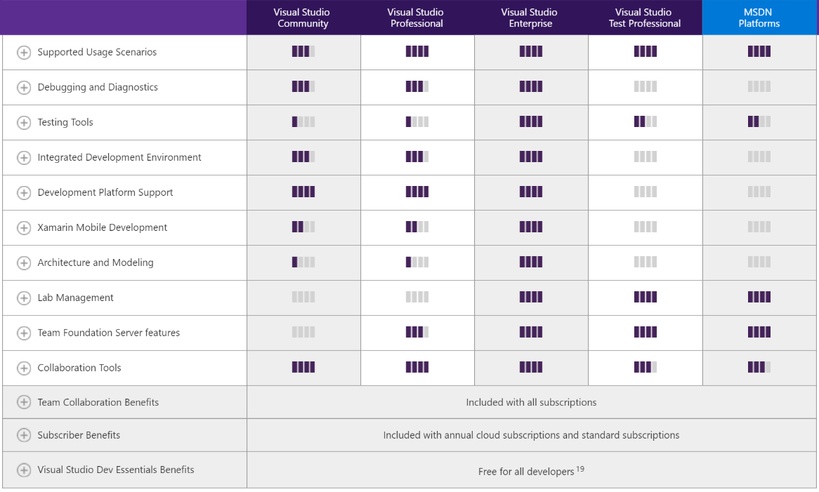
Compare Visual Studio 2015 Offerings

Slide 17
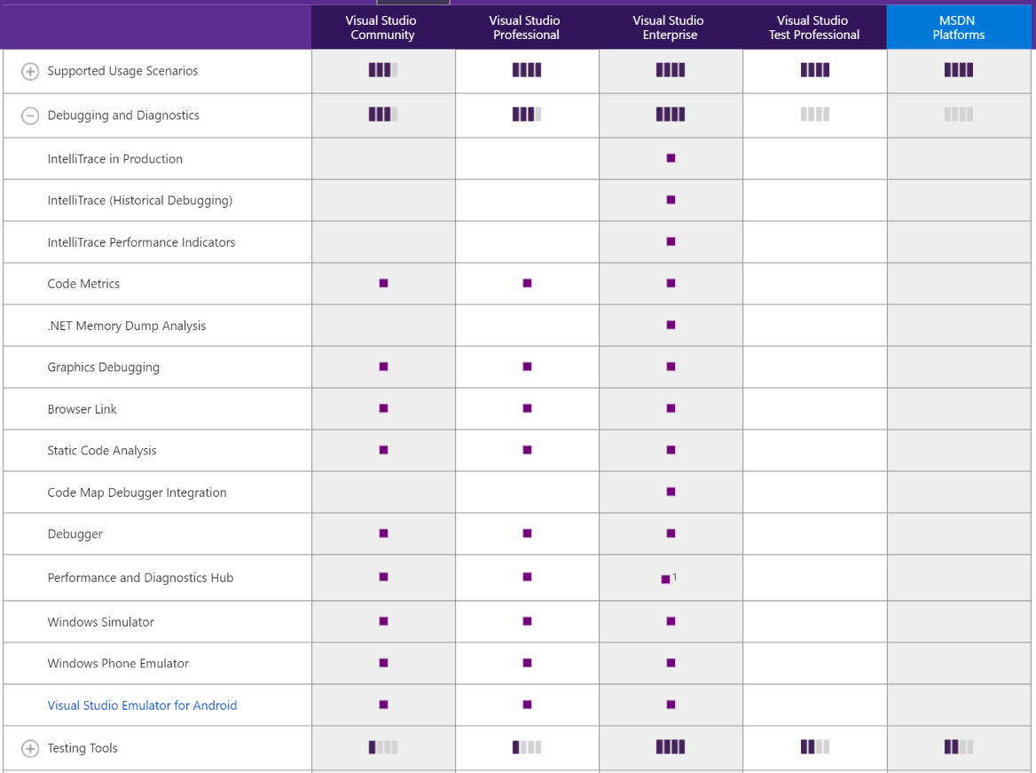
Compare Visual Studio 2015 Offerings

Slide 18
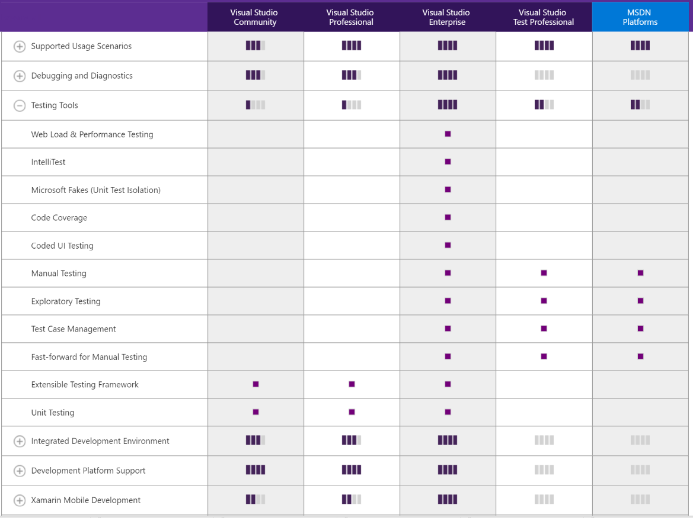
Compare Visual Studio 2015 Offerings

Slide 19
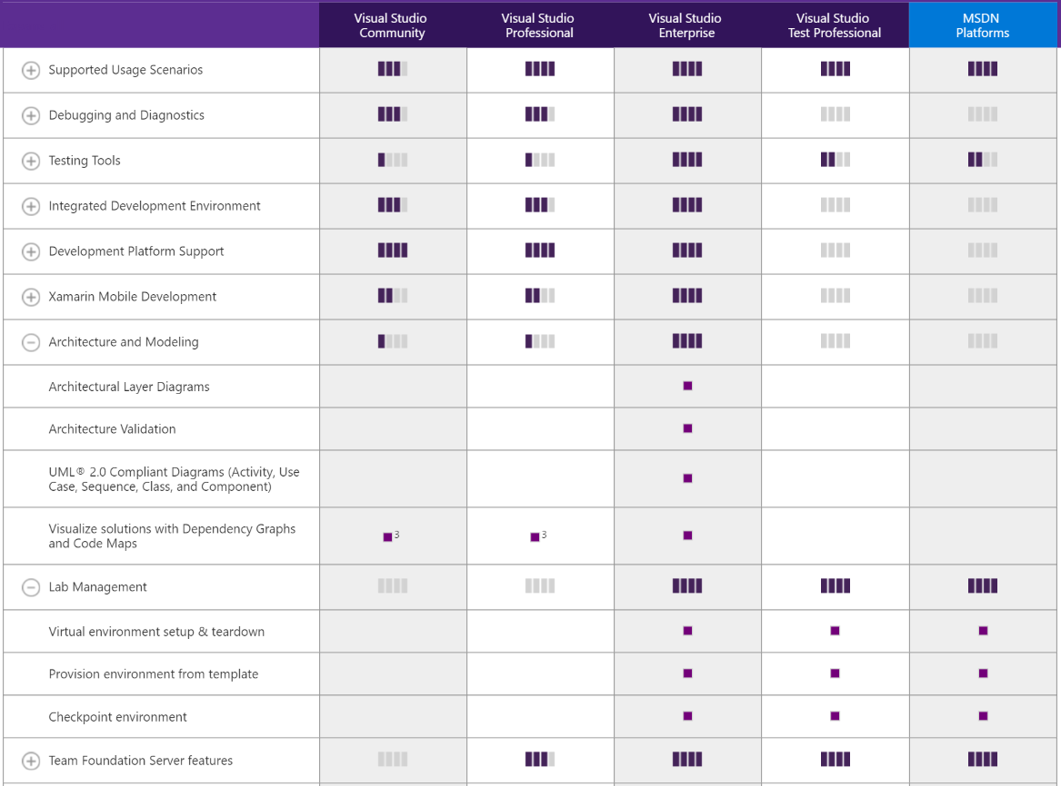
Compare Visual Studio 2015 Offerings

Slide 20
Visual Studio 2015 products
Visual Studio 2013
PROFESSIONAL WITH MSDN
PREMIUM WITH MSDN
ULTIMATE WITH MSDN
PROFESSIONAL WITH MSDN
ENTERPRISE WITH MSDN
Comprehensive collection of software, tools and services for building professional applications with individual and team productivity
End-to-end solution for defining, creating, modernizing and operating business applications in teams with demanding needs of high-scale and high-quality, leveraging Microsoft’s full enterprise platform.
Professional developers looking for individual and team productivity for creating non-mission critical applications.
Unrestricted usage (no VS Community restrictions)
Advanced features for individual and team productivity
Core software for Dev/Test (Windows, Windows Server, SQL Server)
$50/month for Dev/Test on Microsoft Azure, plus Visual Studio Online Basic, Pluralsight training & support
TFS Server/CAL and VSO basic: hybrid agile project management and team collaboration
Developers creating business applications looking for the scale, quality and productivity required in organizations of any size.
Testing (manual testing, IntelliTest, Load Testing, Lab Management, etc.)
Working with large and complex code bases (CodeMap, Code Clone, Code search, IntelliTrace, etc.)
Advanced DevOps (Release Management, IntelliTrace in production)
Virtually all Microsoft software for Dev/Test & Office for production use
$150/month for Dev/Test on Microsoft Azure, plus Visual Studio Online Advanced, Pluralsight training & support

Slide 21
Visual Studio 2015 products
Visual Studio 2013
MSDN PLATFORMS
TEST PROFESSIONAL WITH MSDN
MSDN PLATFORMS
TEST PROFESSIONAL WITH MSDN
MSDN Platforms provides your organization cost effective access to wide range of resources that help you innovate and succeed using Microsoft platforms, without the incremental cost of an IDE.
Visual Studio Test Professional 2015 with MSDN integrates testers, product managers, and other stakeholders directly into the development process with a unified development solution.
IT Pros: Convenient, cost-effective and comprehensive access to Microsoft software and services to set up development and test environments for their IT organization.
Developers: Convenient, cost-effective and comprehensive access to Microsoft software and services to build high-quality applications for the Web, Cloud and Windows.
Comprehensive access to Microsoft software for Dev/Test, including all services
$100/month for Dev/Test on Microsoft Azure, plus Visual Studio Online Advanced, Pluralsight training & support
Testers, Product Managers, Operations Engineers advanced tools, services, and resources they need to drive quality and collaboration throughout the development process.
Exploratory Testing, Manual Testing including fast-forward
Test Case Management, Stakeholder feedback tool
Physical and Virtual Lab Management and Release Management
Agile project management and team collaboration
Quality Dashboards
Core software for Dev/Test (Windows, Windows Server, SQL Server)
$50/month for Dev/Test on Microsoft Azure, plus Visual Studio Online Advanced, Pluralsight training & support

Slide 22
New features in VS 2015 IDE

Slide 23
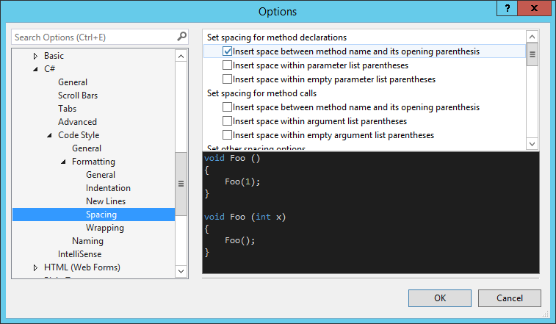
C# and VB Editor new Features
Formatting
demo

Slide 24
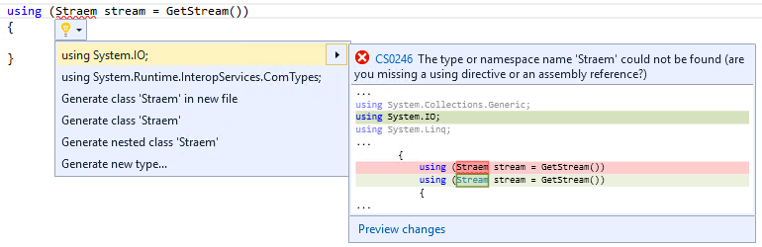
C# and VB Editor new Features
Add Using command - now supports "fuzzy" matching for misspelled types
Notes:
מכירים את זה שאתם משתמשים במחלקה שחסר לה using?
עכשיו ה IDE יאפשר לכם להוסיף גם using אם טעיתם באיות וגם יוסיף reference לפרויקט אם חסר.

Slide 25
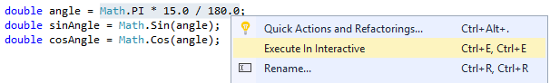
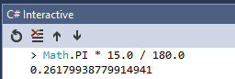
C# Editor new Features
Interactive Window + Execute In Interactive
demo
Notes:
מכירים את זה שאתם רוצים לבדוק API חיצוני אז אתם מייצרים console app או משהו דומה ויושבים לחקור את ה API?
אז נגמרו הימים האלו, אני רוצה להדגים לכם את אחד החידושים היפים בVS2015
החלון האינטרקטיבי הוא חלון מסוג read-eval-print-loop (REPL) עם יכולות עריכה מתקדמות כולל יכולות intelisence ויכולות הגדרה מחדש של מחלקות ופונקציות.

Slide 26
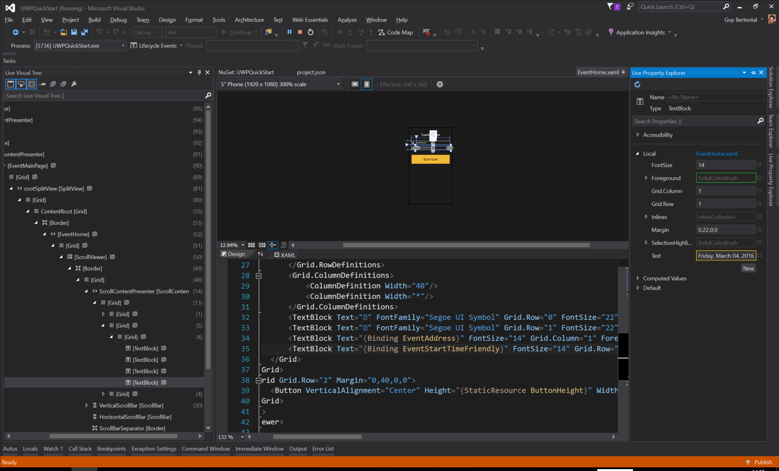

Universal Windows Platform
In-App toolbar
Demo
Notes:
ב

Slide 27
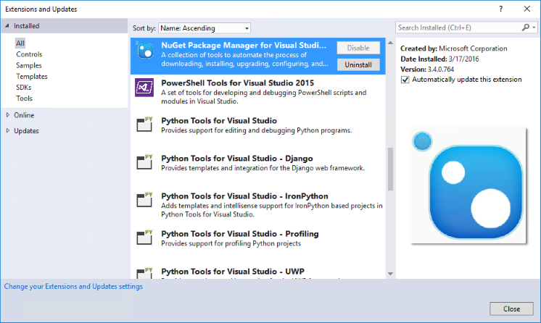
Visual Studio IDE improvements
Auto update extensions

Slide 28
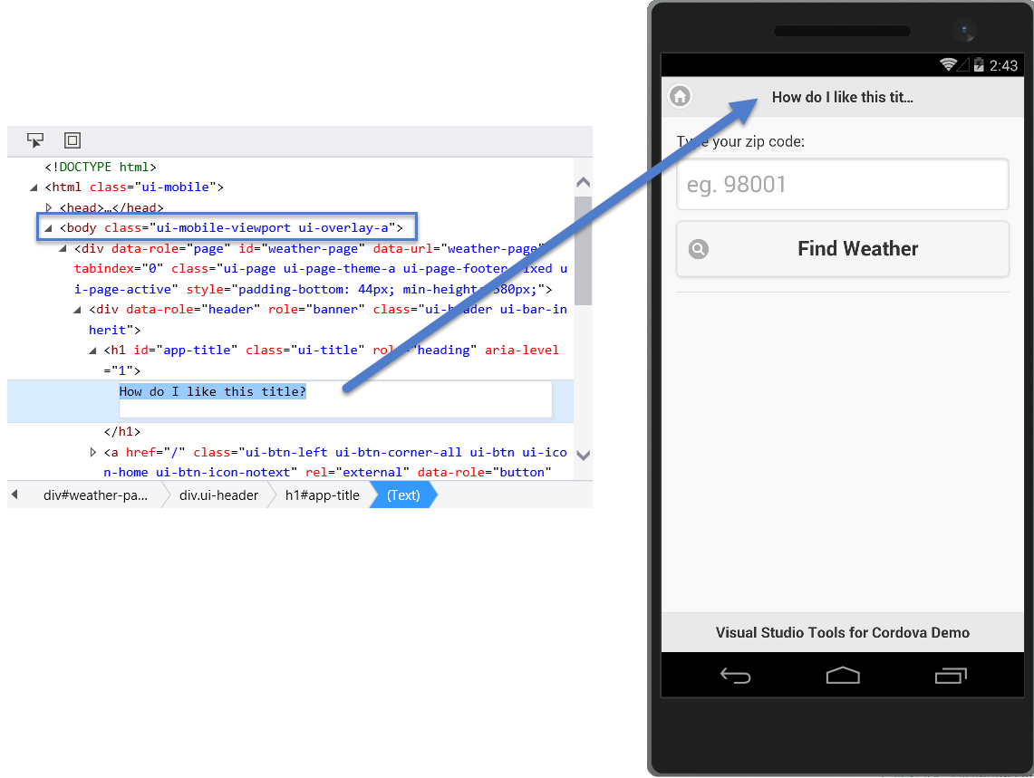
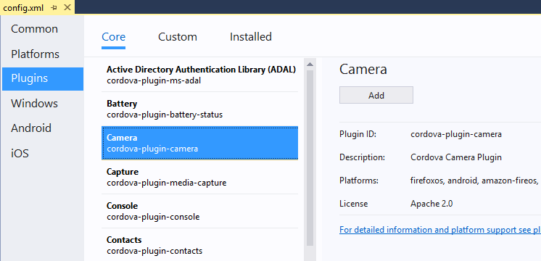
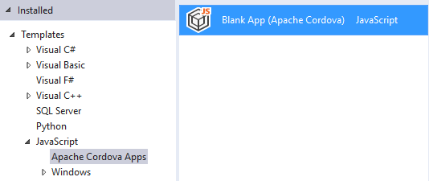
Tools for Apache Cordova
Develop Hybrid mobile apps with VS
http://taco.visualstudio.com/

Slide 29
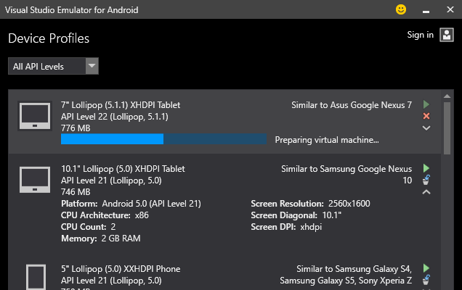

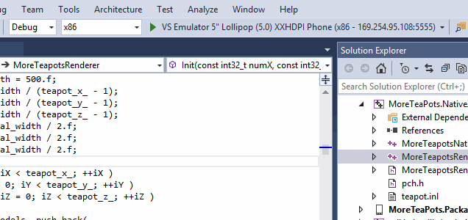
Visual Studio Emulator for Android
Fast Validate your app at lighting speed
Command-line interface. interact with the emulator manager (list, install, start profiles, etc.)
Drag-and-drop zip libraries onto the emulator will now automatically unpack and install it.
SD Card tab push and pull data to and from the SD Card.
Standalone without Visual Studio.

Slide 30




Integration with Package managers and Task Runners
Client-side package
JavaScript libraries, CSS frameworks
Tooling (and client-side package)
Task runners, compilers, bundlers, minifiers
Task runners
Client-side automation

Slide 31
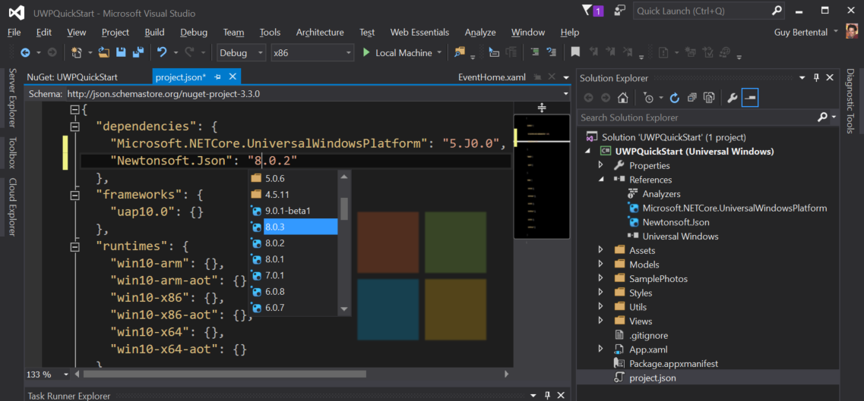
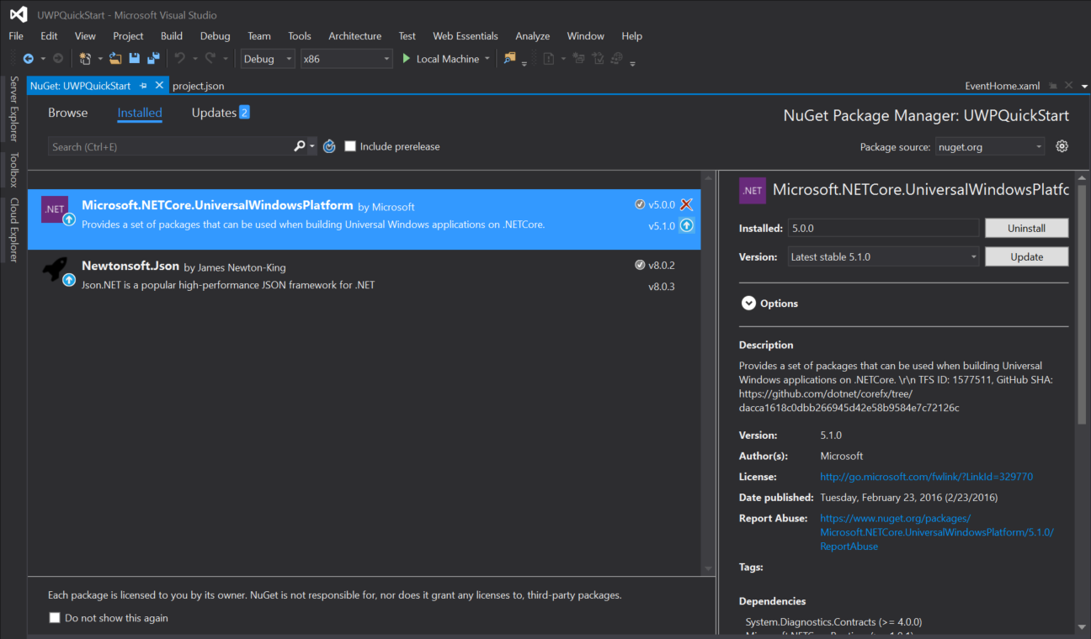
NuGet Package

Slide 32
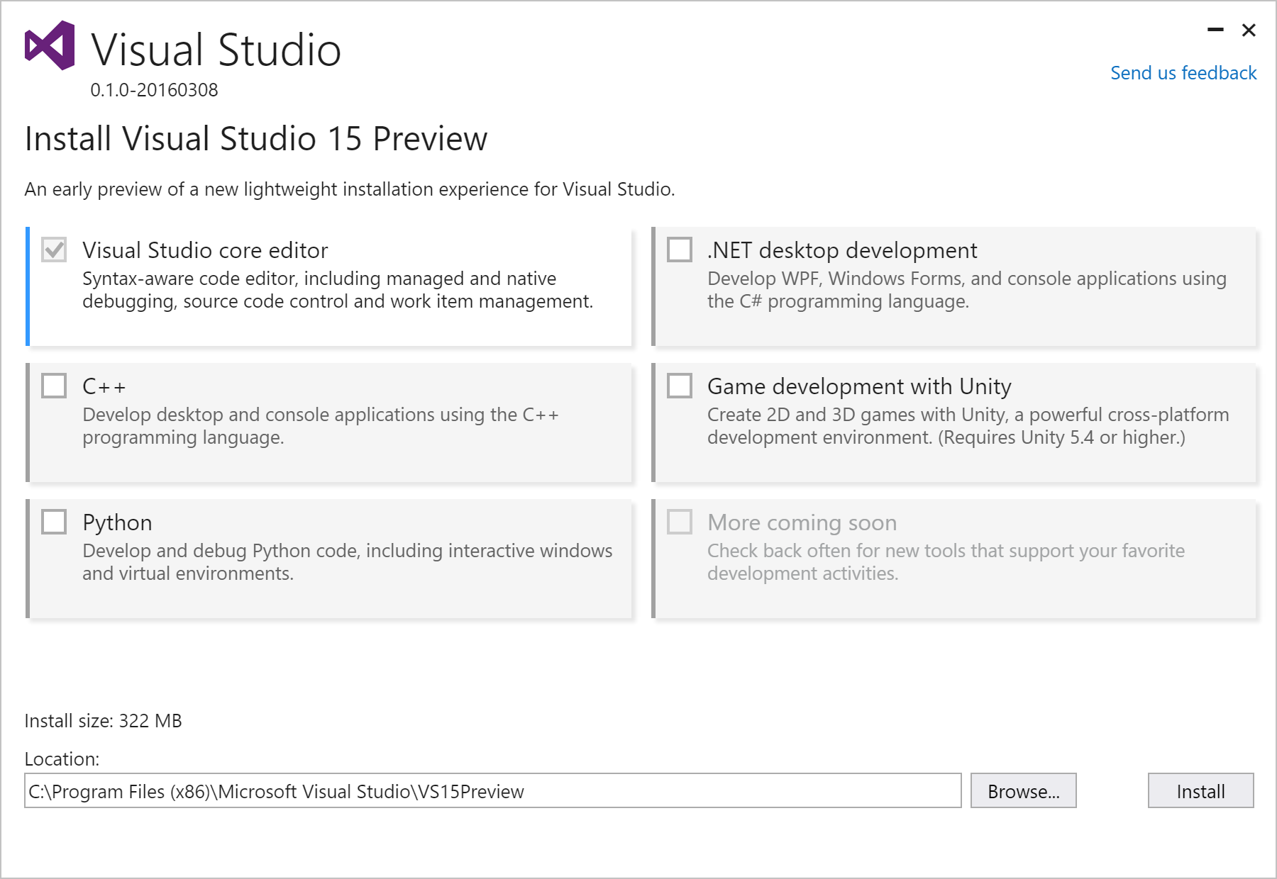
VS “15” - New acquisition experience
Lightweight
Base install 250 MB
Fast
Base install average <180s
Optimized
Installs only what you need
Low impact & isolated
No more MSI and GAC
http://aka.ms/vsnext

Slide 33
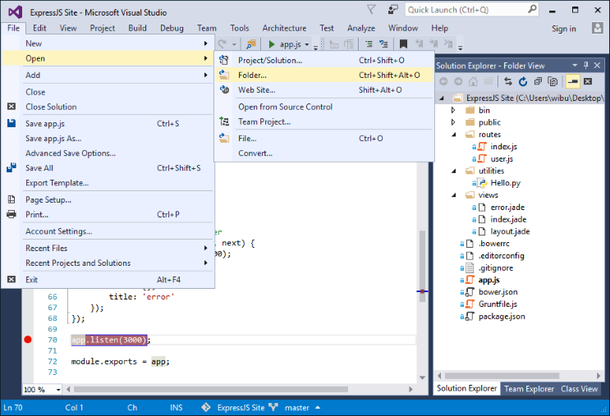
What’s new in Visual Studio 15 preview 2
Open Folder
Notes:
מתאים לתיקיות פייטון סקריפט או nodejs וכדומה

Slide 34
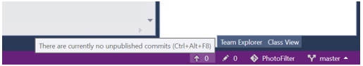
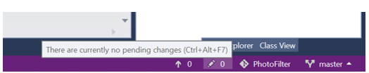
Version control status bar

Slide 35
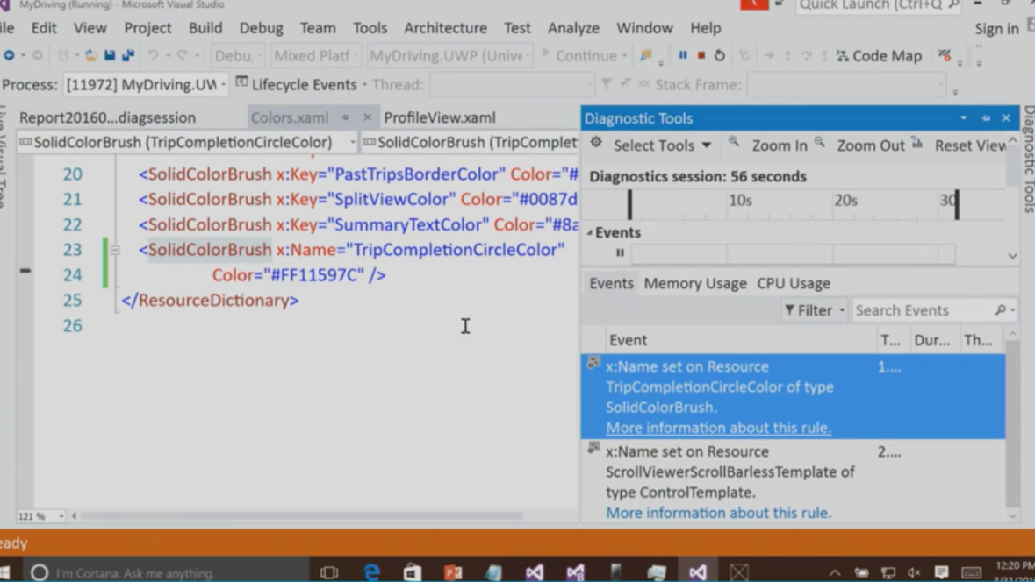
Diagnostic toolbar
UWP performance analyzer
Notes:
ב VS 15 יתווסף tool נוסף עבור UWP אשר יתריע על בעיות ביצועים שיש לנו באפליקציה
בדוגמא הבאה – שימוש ב x:Name במקום ב x:Key
בזבוז זיכרון ו CPU בגלל יצירת type נוסף
x:Name לא יכול ליהנות מ Defer Loading – טעינת ה resource רק כאשר צריך

Slide 36
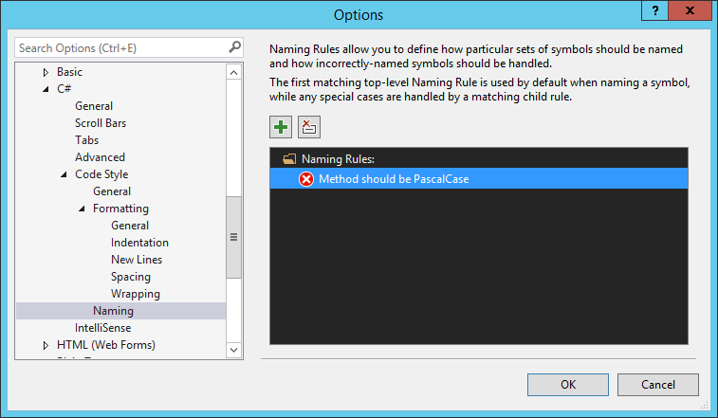
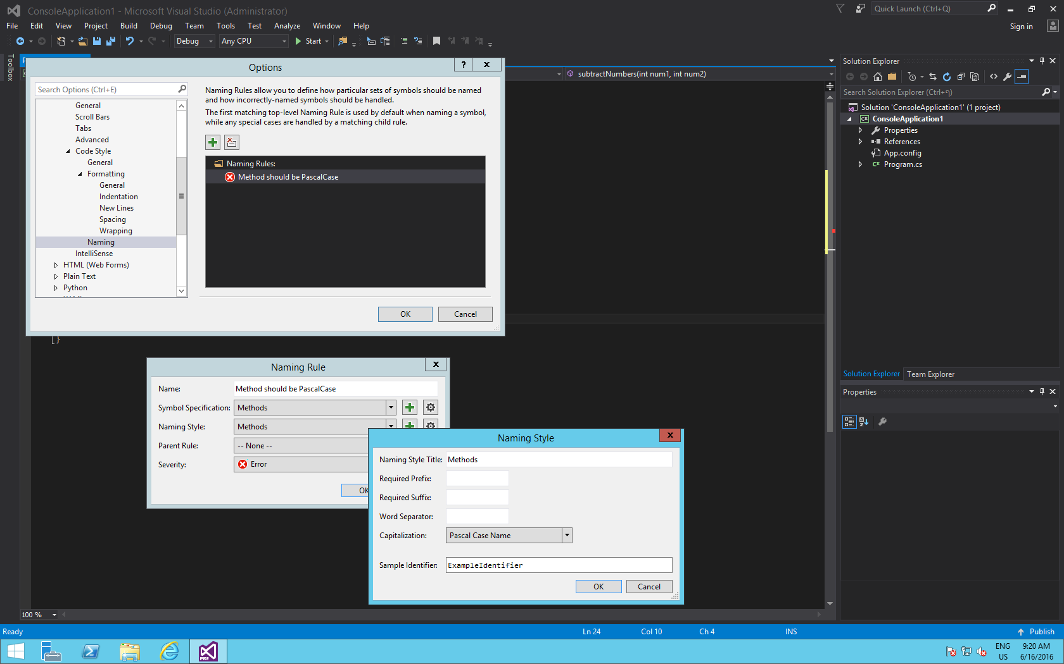
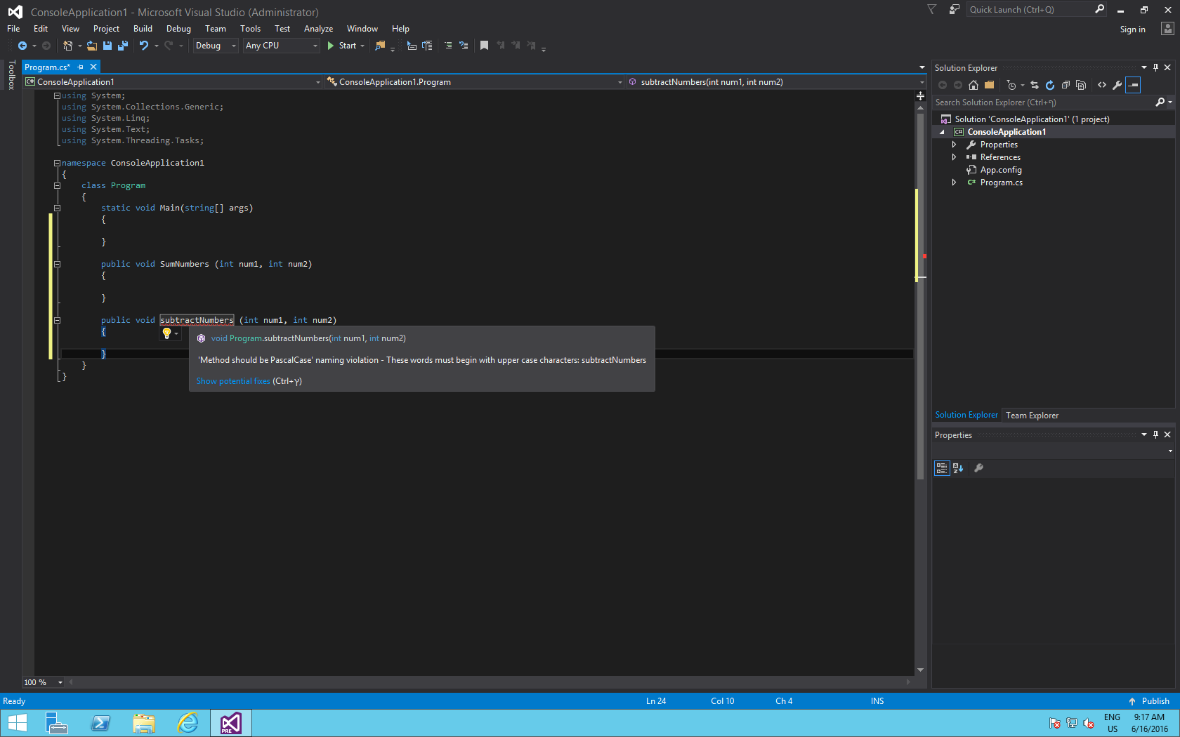
C# and VB Editor new Features
Naming Rules

Slide 37
B
Visual Studio Enterprise features

Slide 38
Key features
Enterprise Agile

Slide 39
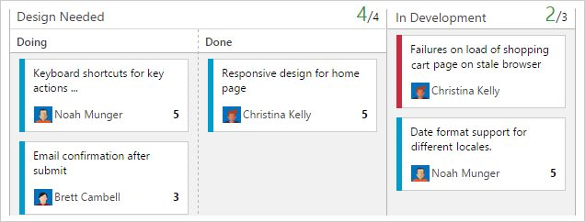
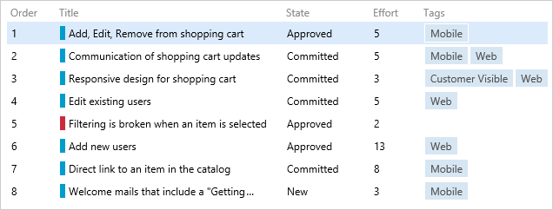
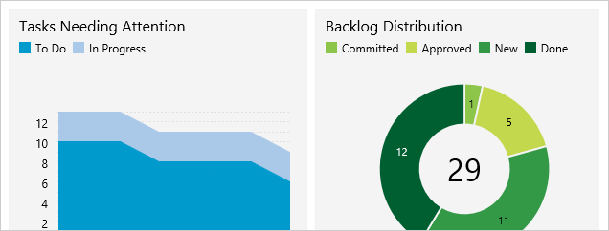

Agile Planning
Tools for the entire team
Monitor all your team’s work - including operational issues - using built-in Kanban boards. Track work in progress to ensure you’ve got a streamlined channel from idea to delivery

Slide 40
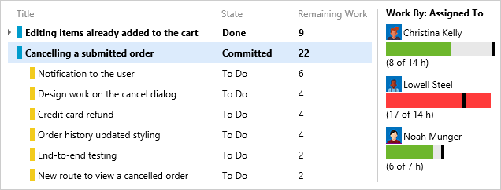
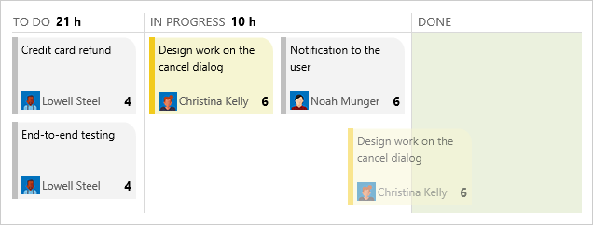
Agile Project Management
Scrum? Absolutely!
Scrum teams will feel right at home. Plan sprints using team-based capacity planning, assign work by dragging-dropping, and monitor progress with real-time burndown charts

Slide 41
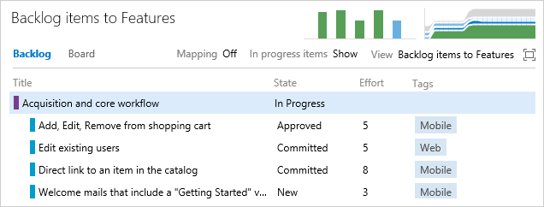
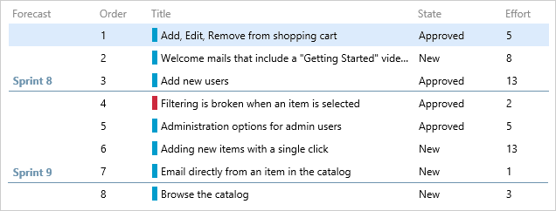
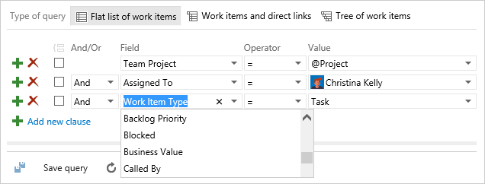
Enterprise Agile
Alignment and autonomy
Agile is not just for your team, it’s for your whole organization. Map every story on your backlog to a business scenario – ensuring you understand how the value being delivered contributes to the needs of your business

Slide 42
Key features
Visibility and transparency

Slide 43
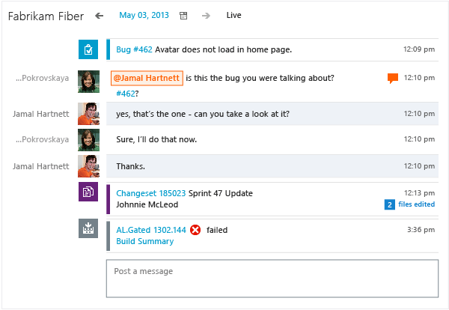
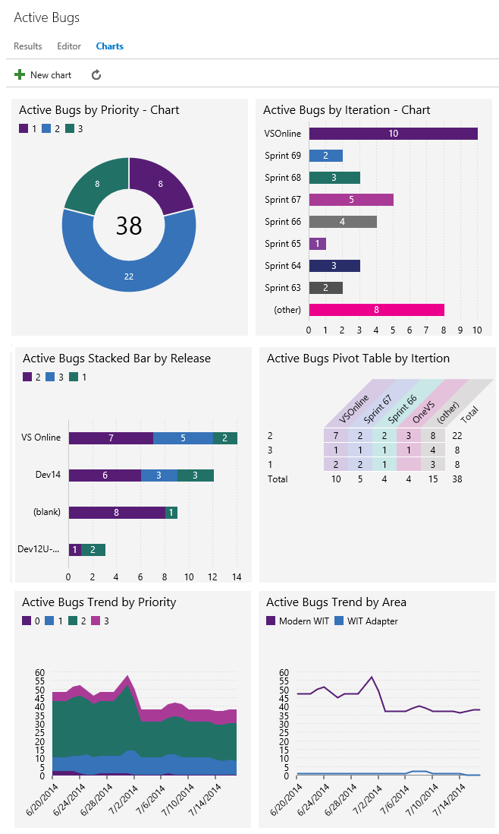
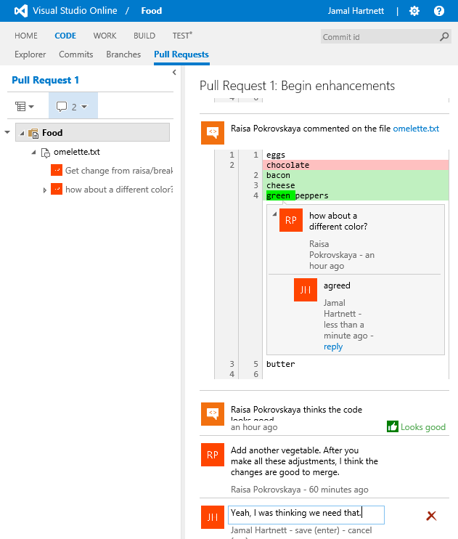
Dashboards and Charts
Dashboards
Build dashboards that provide visibility to your team and stakeholders. Stop worrying where to find things and instead use Visual Studio Online or TFS to get everyone on the same page

Slide 44
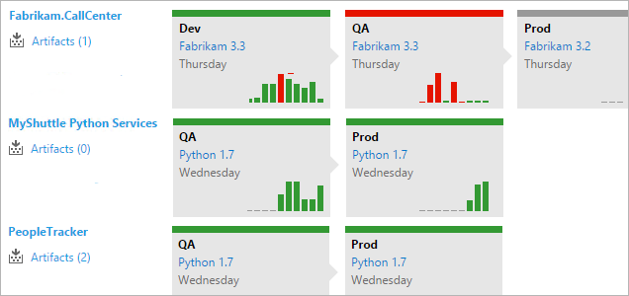
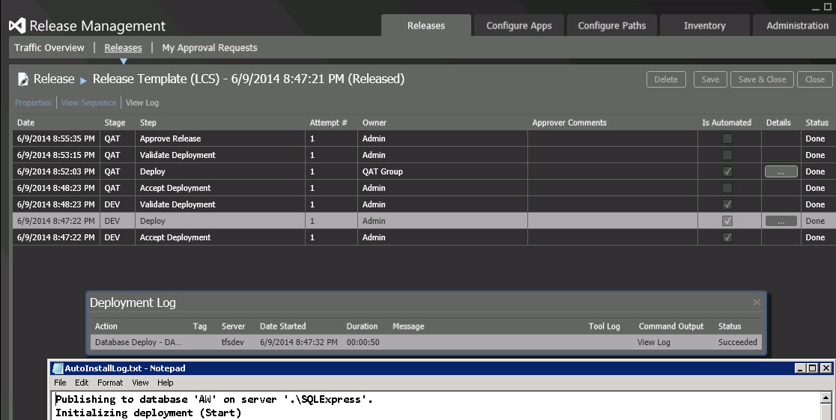
Release Visibility
Continuous delivery
Eliminate uncertainty, lower risk and get visibility on deployments with Release Management
Create automated and repeatable workflows and easily integrate with any build system and release applications faster with less risk
Audit progress of your release at every stage of the deployment pipeline, all the way to production

Slide 45
Key features
Developer productivity: Developer testing

Slide 46
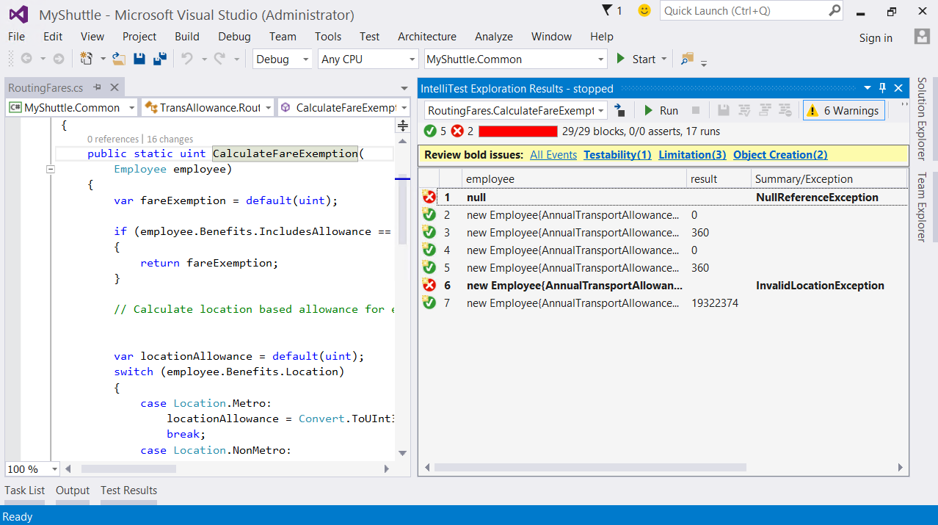
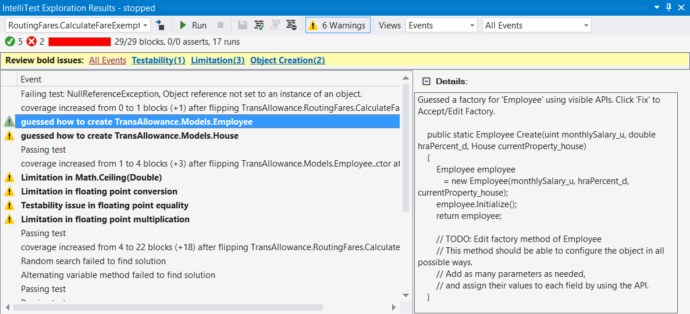
IntelliTest
Unit testing – now better!
Use IntelliTest to quickly generate relevant unit tests for your code - automatically
IntelliTest dramatically reduces the effort required for creating unit tests for new or existing code so you can focus on building new features instead
Easily create sets of unit tests for legacy code that has never been looked at before and increase path coverage and code quality

Slide 47
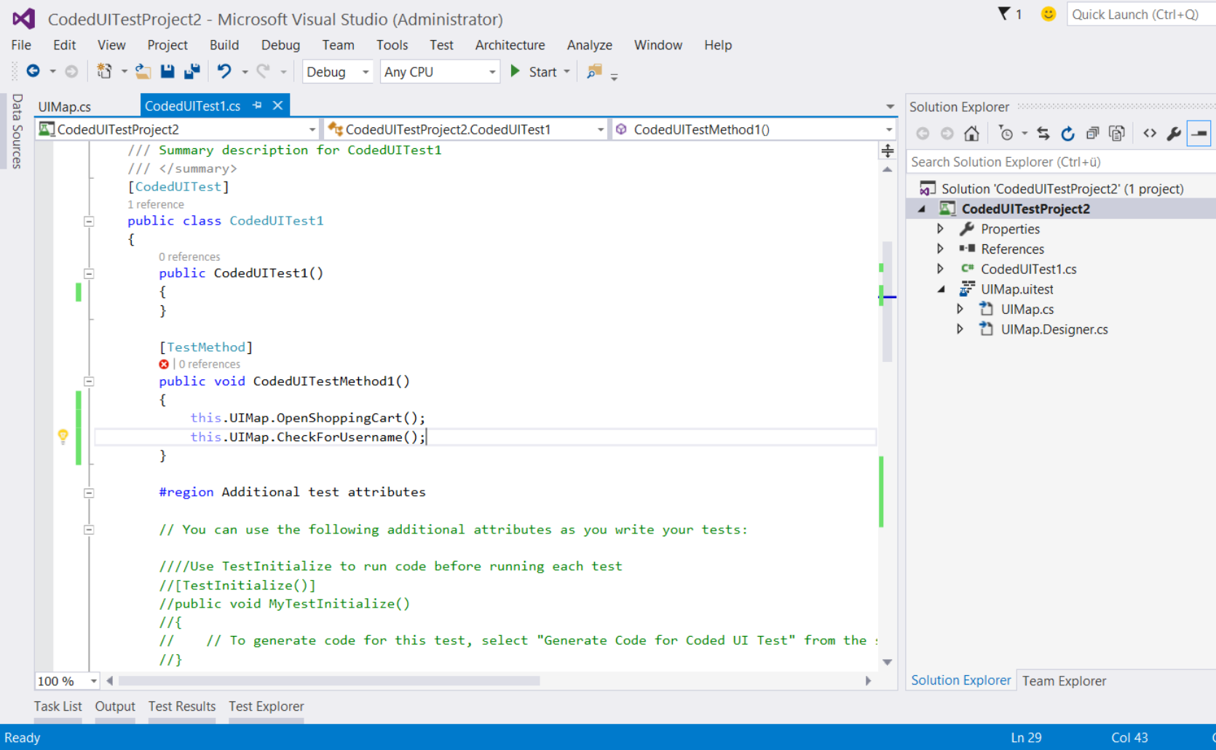
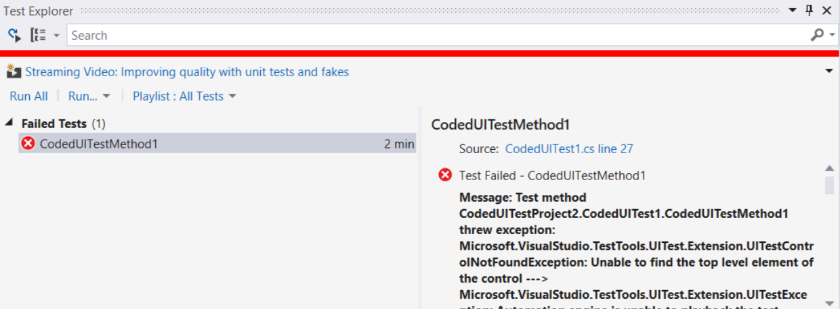
Coded UI
Automate manual testing
Reduce the burden of manual regression testing by using the Coded UI test framework to fully automate UI testing
You can create a coded UI test that can test that the user interface for an application functions correctly. The coded UI test performs actions on the user interface controls for an application and verifies that the correct controls are displayed with the correct values

Slide 48
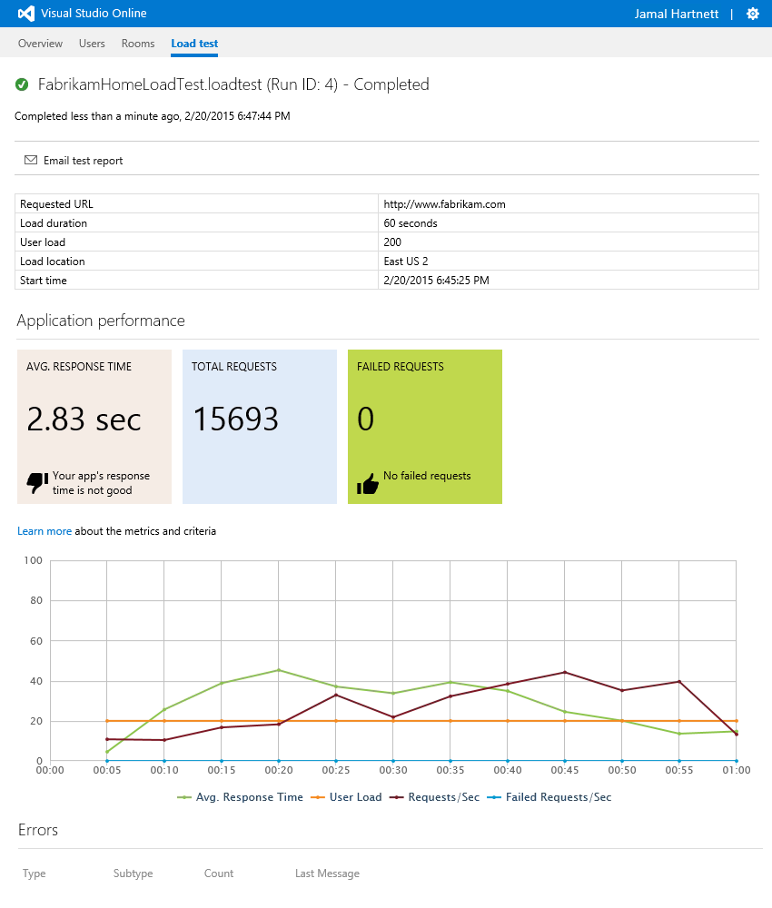
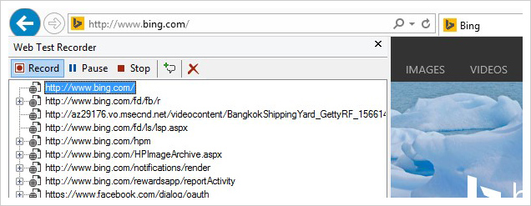
Performance Testing
Know your limits
Visual Studio makes integrating Load Testing into your development process easy and will help you avoid nasty surprises in production
Whether those surprises are caused by world-wide distribution, the scale of your customer base or problems that only manifest in multi-day runs – Visual Studio Load Testing will give you the analytics to solve those problems before you deploy

Slide 49
Key features
Developer productivity: Debugging and Diagnostics

Slide 50
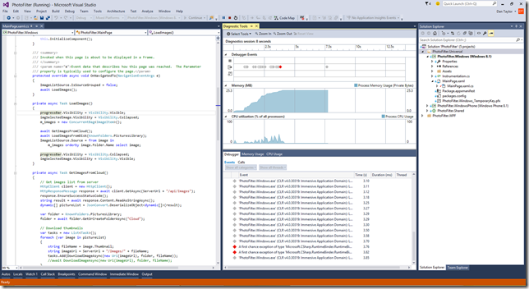

IntelliTrace
No more «No Repro»
Diagnosing unexpected behavior can sometimes take hours of searching through source code and repeated guesses where to set breakpoints
Using the diagnostic tools in Visual Studio 2015 and IntelliTrace you can see the history of your code’s execution and navigate back in time to inspect state without manually setting breakpoints

Slide 51


.net Memory Dump Analysis
Prevent perf issues
Use comprehensive profiling tools without the debugger to get deeper insights into your app’s performance, including CPU, GPU, and memory usage, UI responsiveness, and network utilization

Slide 52


Visual Debugging
Visualize your code
Code Map Debugger Integration enables you to debug complex software problems without getting lost. See exactly where issues happen at debug time, visualize relationships and quickly find and fix problems in your code.

Slide 53

Code Analysis
Validate your code
The code analysis tools in Visual Studio help developers identify potential design, globalization, interoperability, performance and security issues, using a set of Microsoft best practice rules
Running code analysis tools at regular intervals during your development process can enhance the quality of your software by examining your code for common defects and violations

Slide 54
Key features
Test planning and execution

Slide 55



Test Case Management
Streamline quality
Take advantage of a toolset optimized for the needs of testers, giving them flexibility in how they work while at the same time keeping them in sync with the rest of the team
Improved web-based Test Case Management helps testers author, manage and execute test cases using any modern web browser
Microsoft Test Manager further empowers your testers by giving them comprehensive tools for automated and manual testing in a desktop application optimized for the needs of today’s agile QA professional

Slide 56

Manual Testing
Run, record, play back
Capture detailed records of steps performed, behaviors observed, and the status of each test step with the fully-instrumented and configurable Test Runner. Pause testing at any time to report a bug, even if it’s not directly related to the current test case
High-fidelity defect reports go directly to the development team, including all the technical data needed to reproduce and resolve the error quickly. Record tests for later playback to speed up test sessions and enable test automation

Slide 57

Exploratory Testing
Testing, super-charged
Run tests without a pre-defined list of test cases and test steps with exploratory testing. Create action recordings, capture rich comments and screenshots and quickly report bugs
Testers can easily create test cases, complete with test steps, from exploratory test recordings which can then be added to test plans and suites for future testing activities
Simultaneous test design and execution saves time and effort and allows testers to create real-world test scenarios, fast

Slide 58
Key features
Manage complex solutions: Architecture and modeling

Slide 59


Architectural Layer Diagrams
Model and design
Make sure your application meets user requirements and use Visual Studio to understand the code and model your application. Visual Studio helps you visualize code so you can understand structure, relationships, and behavior more easily
Create models at different levels of detail and track requirements, tasks, test cases, bugs or other work associated with your models by linking model elements to work items and your development plan

Slide 60
Architecture Validation
Analyze and validate
Create dependency graphs to understand different dependencies at a high level, between assemblies or binaries, namespaces, or even arbitrary groups. Drill into dependencies on the graph to see how they're related
Create layer diagrams to specify what those dependencies should look like to meet design requirements. Find out where the current code doesn't meet those constraints and help your team manage technical debt

Slide 61
UML Diagrams
Clarify intent
Modeling diagrams help you understand, clarify, and communicate ideas about your code and the user requirements that your software system must support. To describe and communicate the functionality of your system, you can use UML component, class, activity, and sequence diagrams in Visual Studio

Slide 62


Code Maps
Visualize your code
Map relationships in code with code maps. When you create code maps, they appear next to the code editor
This lets you focus on the task at hand because you can see your place while you work and helps you understand relationships in code
Navigate these relationships using the map which updates as you traverse your code base

Slide 63
Key features
Close the loop and lower cycle times

Slide 64


IntelliTrace in Production
Diagnose and fix issues
The IntelliTrace stand-alone collector lets you collect IntelliTrace diagnostic data for your apps on production servers or other environments without installing Visual Studio on the target machine and without changing the target system's environment. When you're done collecting data, just delete the collector to uninstall it

Slide 65


Feedback Management
Actionable feedback
Once you have working software, you're ready to get feedback from your stakeholders. You can ask reviewers to provide videos, screenshots, type-written comments, and ratings
Their feedback is captured into work items that you can review and use to create a bug or suggest a new backlog item

Slide 66


Application Insights
Usage and performance
Get a 360° view of your app that includes availability, performance and user behavior
Use a powerful and easy-to-use experience to track and improve the success of your application
Analyze data across dimensions and make informed decisions about your product’s future

Slide 67
Key features
Enterprise DevOps

Slide 68


Lab Management
Dev/Test lab environments
Automate your virtual lab environment with Visual Studio Lab Management
Use templates to define/launch environment configurations for consistent testing
Provision dev/test lab environments quickly for testers and developers

Slide 69

Release Management
Ship better apps, faster
Visual Studio Release Management makes it easy to automate deployment and testing of your applications in multiple environments
Teams can create release definitions and automate deployment in repeatable, reliable ways while tracking simultaneous in-flight releases
Incorporate automated functional tests or manual approvals in a release definition to automate the release process all the way to production

Slide 70





Cloud Dev/Test Environments
Developer Machine
Team Collaboration
Agile, flexible, scalable
React faster to business changes and keep up with dev and test infrastructure demands
Reduce effort and lower cost for dev and test infrastructure resources
Get the compute, storage, and network resources you need, in minutes instead of hours or days
Test applications in a ‘production-like’ environment
Dev and Test
Production

Slide 71


We want to hear from you!
Inside Visual Studio
Outside Visual Studio
Report a problem
“I ran into an issue”
Send a suggestion
“I have a great idea”
Rate this product
“I love Visual Studio!”
Take surveys
“I have more to tell you”
Forums
Social channels
@visualstudio

Slide 72


We want to hear from you!

Slide 73
Resources from Build 2016
Session code | Title | Speaker
B880 | Top 6 Reasons to Move Your C++ Code to Visual Studio 2015 | Ankit Asthana, Andrew Hall, Marian Laparu
B886 | Visual Studio 2015 Extensibility | Mads Kristensen
B836 | Cross-Platform Mobile with Xamarin | Miguel de Icaza
B891 | .NET Overview | Scott Hanselman, Scott Hunter
B889 | The Future of C# | Dustin Campbell; Mads Torgersen
B819 | Become a Visual Studio 2015 Power User | Allison Buchholtz-Au; Andrew Hall
B824 | Building Desktop Apps in Visual Studio vNext | Unni Ravindranathan

